Slide 1


UNIVERSITY INSTITUTE OF ENGINEERING
COMPUTER SCIENCE & ENGINEERING
Introduction to Information Security
(Subject Code:20CST-354/ITT-354)
Prepared By : Er. Puneet kaur(E6913)
INTRODUCTION
DISCOVER . LEARN . EMPOWER

Slide 2

Authentication Requirements
www. cuchd.in Campus : Gharaun, Mohali

Slide 3
In the context of communications across a network, the following attacks can be identified:
1. Disclosure: Release of message contents to any person or process not possessing
the appropriate cryptographic key.
2. Traffic analysis: Discovery of the pattern of traffic between parties. In a connection oriented application, the frequency and duration of connections could be determined. In either a connection-oriented or connectionless environment, the number
and length of messages between parties could be determined.
3. Masquerade: Insertion of messages into the network from a fraudulent source.
This includes the creation of messages by an opponent that are purported to
come from an authorized entity. Also included are fraudulent acknowledgments
of message receipt or nonreceipt by someone other than the message recipient.

Slide 4
Authentication Requirements
4. Content Modification: Changes to the contents of a message, including insertion,
deletion, transposition, or modification.
5. Sequence modification: Any modification to a sequence of messages between
parties, including insertion, deletion, and reordering.
6. Timing modification: Delay or replay of messages. In a connection-orientated
application, an entire session or sequence of messages could be a replay of some
previous valid session, or individual messages in the sequence could be delayed
or replayed.
7. Repudiation: Denial of receipt of message by destination or denial of transmission
of message by source.

Slide 5
Message authentication
Message authentication is a procedure to verify that received messages come from
the alleged source and have not been altered. Message authentication may also verify
sequencing and timeliness. A digital signature is an authentication technique that also includes measures to counter repudiation by either source or destination.

Slide 6
Authentication Functions Types
Message Encryption: The ciphertext of the entire message serves as its authenticator.
2. Message Authentication Code1 (MAC): A public function of the message and a secret key that produces a fixed length value that serves as the authenticator.
3. Hash Functions: A public function that maps a message of any length into a
fixed length hash value, which serves as the authenticator.

Slide 7
Hash Functions
The principal object of a hash function is data integrity.
A hash function H accepts a variable-length block of data M as input and produces a fixed-size hash value
h = H(M)
A change to any bit or bits results a change to the hash code.
The kind of hash function needed for security applications is referred to as a cryptographic hash function.

Slide 8
Hash Functions…….
A cryptographic hash function is an algorithm for which it is computationally infeasible to find either
A data object that maps to a pre-specified hash result (The one-way property)
Two data objects that map to the same hash result (The collision-free property).
Because of these characteristics, hash functions are often used to determine whether or not data has changed.

Slide 9
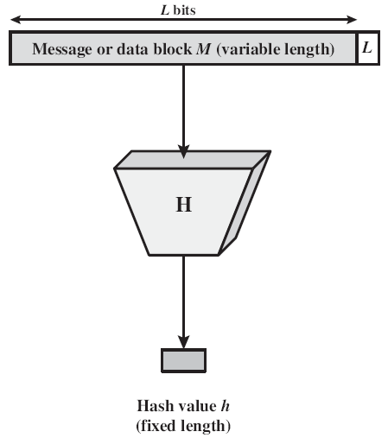
General Operation of Cryptographic Hash Function
Input is padded to an integer multiple of some fixed length
Padding includes the value of the length of the original message in bits.
The length field is used to increase the difficulty for an attacker to produce an alternative message with the same hash value.

Slide 10
Applications of Cryptographic Hash Function
Message Authentication
Message authentication is a mechanism or service used to verify the integrity of a message.
Message authentication assures that data received are exactly as sent (i.e., contain no modification, insertion, deletion, or replay).
Sometimes, there is a requirement that the authentication mechanism assures that purported identity of the sender is valid.

Slide 11
Applications of Cryptographic Hash Function
When a hash function is used to provide message authentication, the hash function value is referred to as a Message Digest.
Hash code can be used in a variety of ways to provide message authentication.

Slide 12
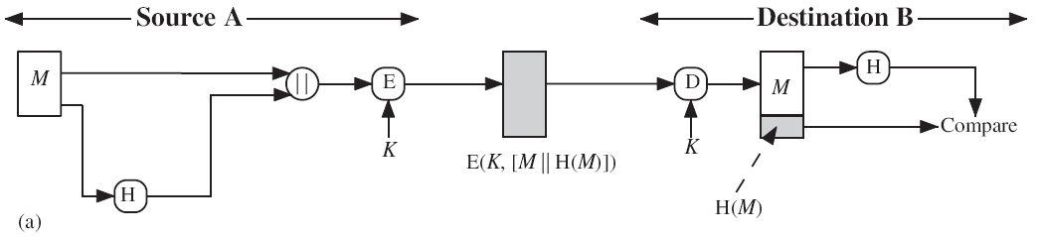
Applications of Cryptographic Hash Function
The message plus concatenated hash code is encrypted using symmetric encryption. Because only A and B share the secret key, the message must have come from A and has not been altered. The hash code provides the structure or redundancy required to achieve authentication. Because encryption is applied to the entire message plus hash code, confidentiality is also provided.

Slide 13
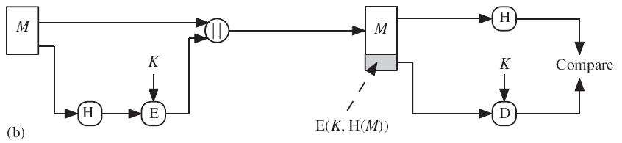
Applications of Cryptographic Hash Function
Only the hash code is encrypted, using symmetric encryption. This reduces the processing burden for those applications that do not require confidentiality.

Slide 14
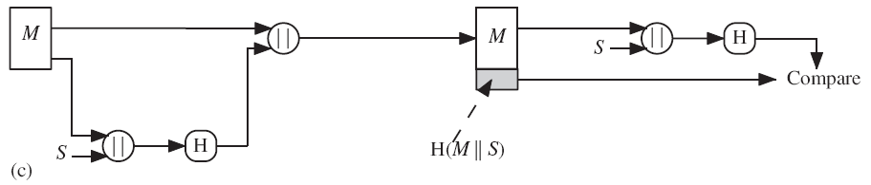
Applications of Cryptographic Hash Function
It is possible to use a hash function but no encryption for message authentication. The technique assumes that the two communicating parties share a common secret value S.A computes the hash value over the concatenation of M and S and appends the resulting hash value to . Because B possesses , it can recompute the hash value to verify. Because the secret value itself is not sent, an opponent cannot modify an intercepted message and cannot generate a false message.

Slide 15
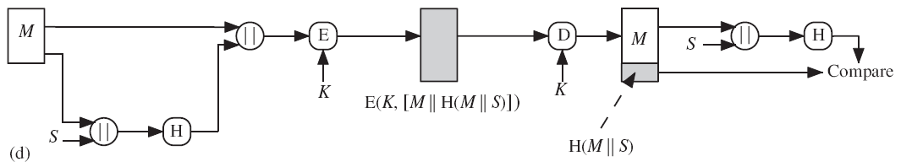
Applications of Cryptographic Hash Function
Confidentiality can be added to the approach of method (c) by encrypting the entire message plus the hash code.

Slide 16
Applications of Cryptographic Hash Function
When confidentiality is not required, method (b) takes less computation time as compared to methods (a) and (d).
There has been growing interest in techniques that avoid encryption . Several reasons for this interest are :
Encryption software is relatively slow.
Encryption hardware costs are not negligible.
Encryption hardware is optimized toward large data sizes. For small blocks of data, a high proportion of the time is spent in initialization/invocation overhead.
Encryption algorithms may be covered by patents, and there is a cost associated with licensing their use.

Slide 17
Applications of Cryptographic Hash Function
More commonly, message authentication is achieved using a Message Authentication Code (MAC), also known as a keyed hash function.
Typically, MACs are used between two parties that share a secret key to authenticate exchanged information
A MAC function takes as input a secret key and a data block and produces a hash value, referred to as the MAC.
This can then be transmitted with or stored with the protected message.

Slide 18
Applications of Cryptographic Hash Function
If the integrity of the message needs to be checked, the MAC function can be applied to the message and the result compared with the stored MAC value.
An attacker who alters the message will be unable to alter the MAC value without knowledge of the secret key.
Verifying party also knows who the sending party is because no one else knows the secret key.

Slide 19
Applications of Cryptographic Hash Function
Digital Signatures
The hash value of a message is encrypted with a user’s private key.
Anyone who knows the user’s public key can verify the integrity of the message that is associated with the digital signature.
In two ways a hash code can be used to provide a digital signature.

Slide 20
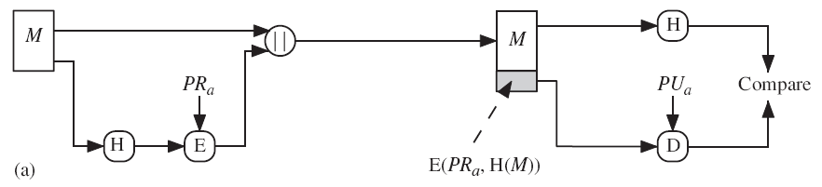
Applications of Cryptographic Hash Function
The hash code is encrypted, using public-key encryption with the sender’s private key. This provides authentication and digital signature.

Slide 21
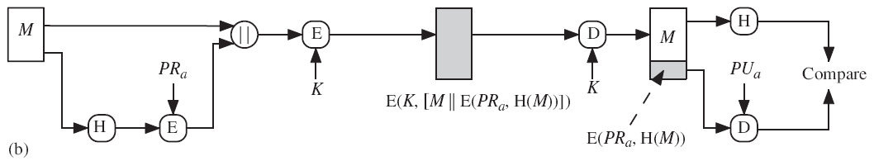
Applications of Cryptographic Hash Function
If confidentiality as well as a digital signature is desired, then the message plus the private-key-encrypted hash code can be encrypted using a symmetric secret key. This is a common technique.

Slide 22
Applications of Cryptographic Hash Function
Other Applications
To Create One way Password File
Intrusion detection
Virus detection

Slide 23
Applications of Cryptographic Hash Function
To Create One way Password File
Hash functions are commonly used to create a one-way password file. A hash of a password is stored by an operating system rather than the password itself.
Actual password is not retrievable by a hacker who gains access to the password file.
When a user enters a password, the hash of that password is compared to the stored hash value for verification.

Slide 24
References
http://www.brainkart.com/article/Classical-Encryption-Techniques_8339/
https://www.tutorialspoint.com/cryptography/index.htm
https://www.geeksforgeeks.org/cryptography-introduction/
https://www.techopedia.com/definition/1770/cryptography#:~:text=Cryptography%20involves%20creating%20written%20or,information%20to%20be%20kept%20secret.&text=Information%20security%20uses%20cryptography%20on,transit%20and%20while%20being%20stored.
https://www2.slideshare.net/lineking/classical-encryption-techniques-in-network-security?qid=e388c29f-793d-4f2b-bcaf-9d22e9ca07b5&v=&b=&from_search=1

Slide 25
E- Books Recommended
https://www.pdfdrive.com/cyber-security-books.html
https://bookauthority.org/books/new-cyber-security-ebooks
https://bookauthority.org/books/best-cyber-security-ebooks
https://www.freetechbooks.com/information-security-f52.html

